Slide 1
Electricity Consumption project
Mentorness Internship
Name: Fahad Ur Rehman

Slide 2
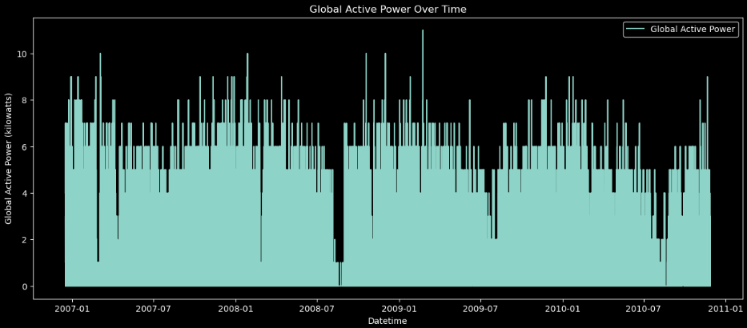
Global Active Power Over Time
Observations:
There are periodic spikes in the global active power consumption.
There seems to be a general pattern of fluctuations over time, with some periods showing higher activity than others.
There are noticeable dips in consumption around mid-2008 and again towards the end of the dataset.

Slide 3
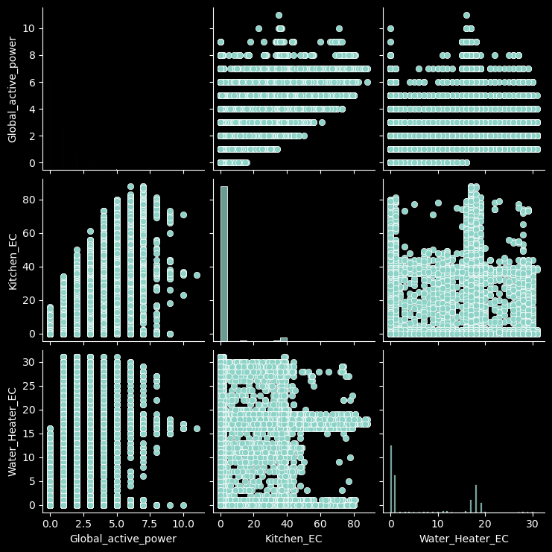
Visualizing Relationships Between Features
Diagonal Plots:
Global_active_power: Mostly 0-2.5 kW, peaks up
to 10 kW.
Kitchen_EC:
Values range 0-60, with distinct intervals.
Water_Heater_EC:
Mostly 0-25, with noticeable peaks.
Off-Diagonal Plots:
Global_active_power vs. Kitchen_EC:
Positive linear correlation.
Global_active_power vs. Water_Heater_EC:
Positive but less clear correlation.
Kitchen_EC vs. Water_Heater_EC: No strong
correlation, values widely spread.

Slide 4
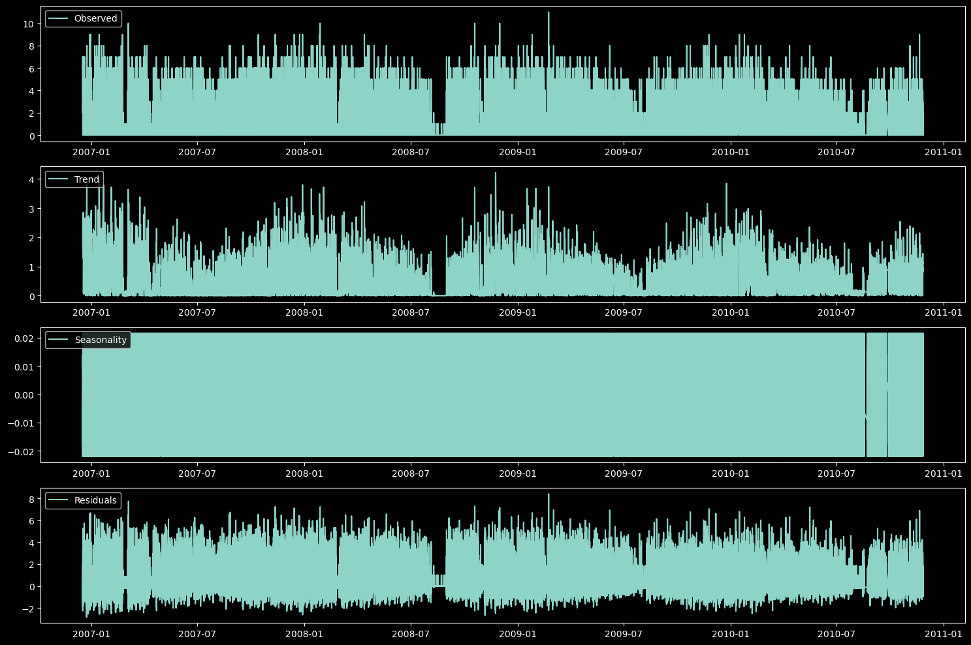
Analyzing Seasonality and Trends
Observed: This shows the observed values over time, with irregular fluctuations.
Trend: This shows the overall trend in the data, with periods of increase and decrease.
Seasonality: This shows the seasonal component of the data, with small periodic variations.
Residuals: This shows the remaining variation in the data after accounting for the trend and seasonality components.

Slide 5
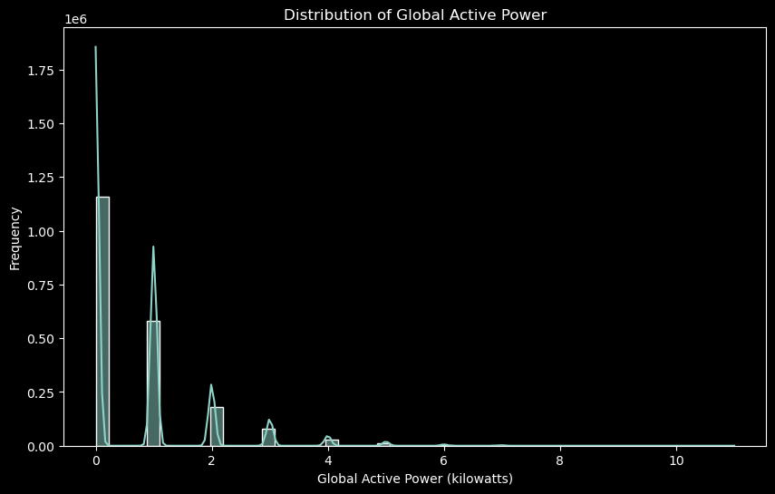
Distribution of Global Active Power
Observations:
The plot shows the distribution of global active power (in kilowatts)
It has a highly skewed shape, with a long right tail
The majority of the distribution is concentrated around 1.5 kW
There are occasional spikes at higher power values, but they are less frequent

Slide 6
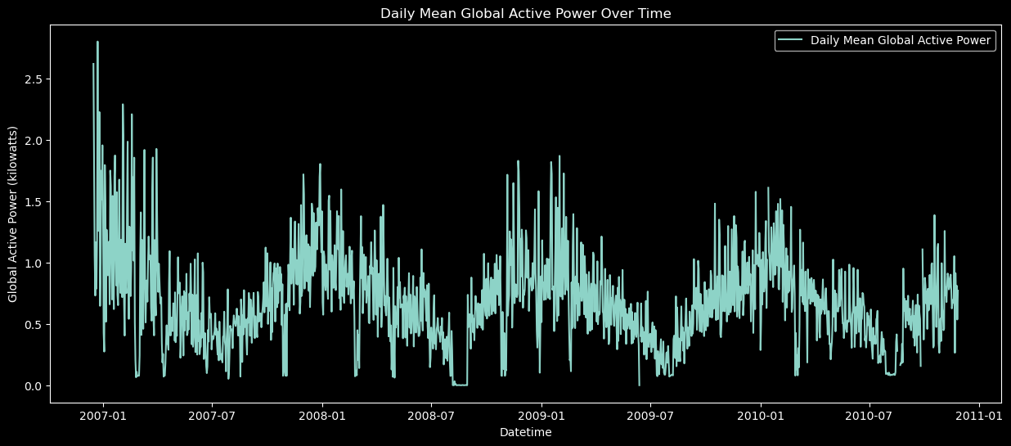
Daily Mean Global Active Power Over Time
Observations:
Depicts daily global active power over time from 2007-2011
Highly volatile and fluctuating pattern with significant spikes and drops
Overall trend shows increasing global power usage over the 4-year period
Greater variability and higher magnitude of fluctuations in later years
Provides detailed view of daily changes in worldwide energy consumption

Slide 7
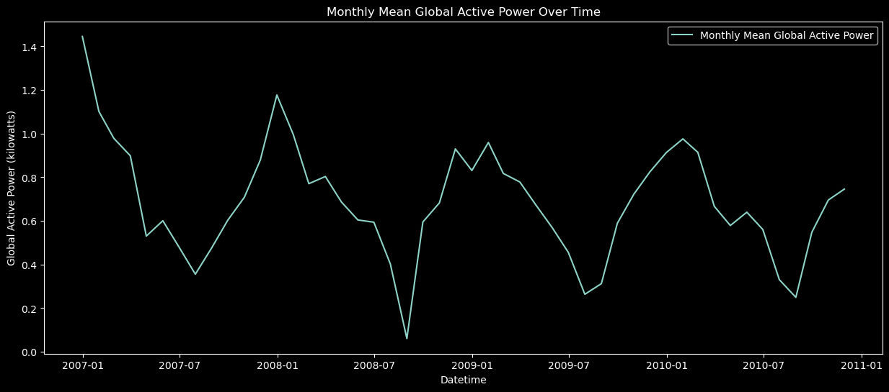
Monthly Mean Global Active Power Over Time
Observations:
The plot exhibits a highly fluctuating and volatile pattern, with significant peaks and valleys in the monthly global active power.
There is an overall increasing trend in the global active power over the 4-year period, with the highest peak occurring around mid-2008.
After the 2008 peak, the monthly active power levels show a general decreasing trend, with some oscillations, until 2010.
From 2010 onwards, the monthly active power levels appear to stabilize, fluctuating within a narrower range compared to the earlier years.
The magnitude and frequency of the fluctuations vary greatly over the time period, suggesting significant changes in global energy consumption and demand patterns.

